Slide 1
F1 data
File created on: 12/10/25 8:10:26 PM CST

Slide 2


Slide 3
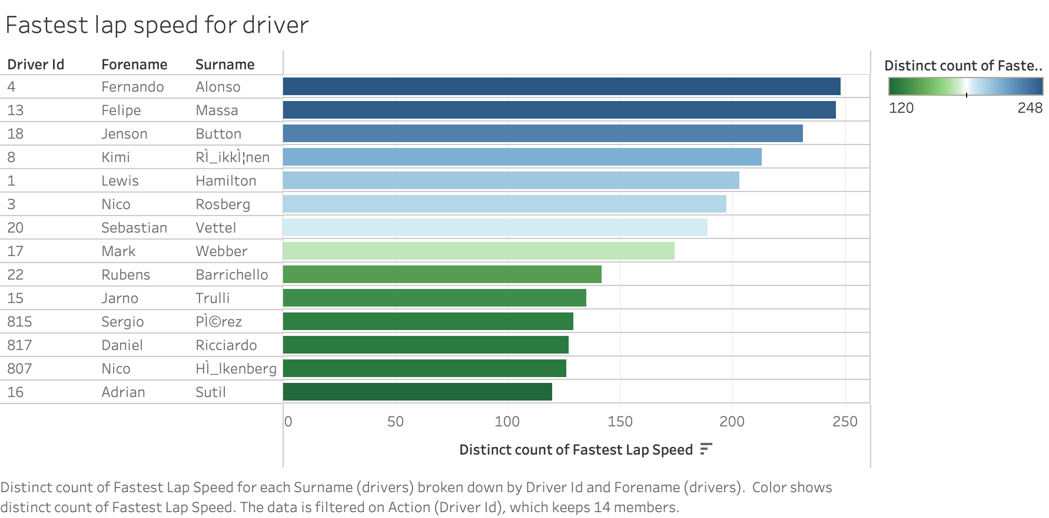

Slide 4
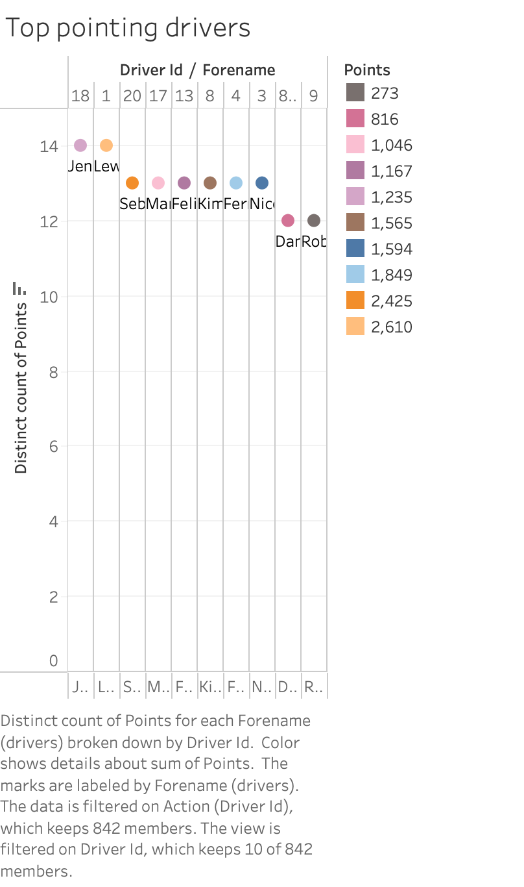

Slide 5
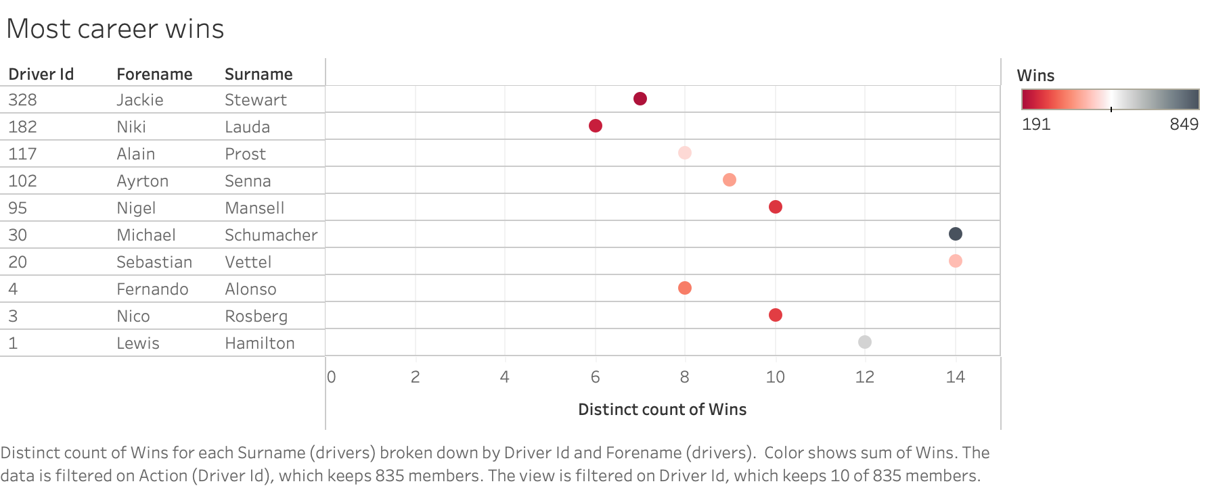

Slide 6
